Slide 1
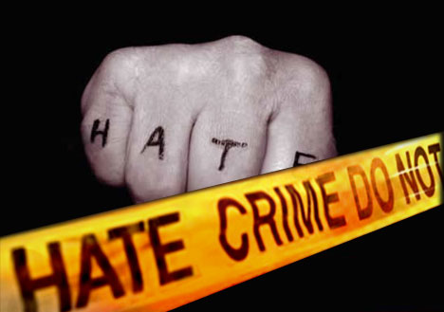
Combating hate crimes
Cody Blasio

Slide 2
Hate definition and back ground information on hate crimes
Hate -Feel intense or passionate dislike for somebody
hate crimes was first noticed by congress in the late 1990s
Crimes of hatred and prejudice—from lynching to cross burnings to vandalism of synagogues—are a sad fact of American history, but the term “hate crime” did not enter the nation’s vocabulary until the 1980s, when emerging hate groups like the Skinheads launched a wave of bias-related crime. The FBI began investigating what we now call hate crimes as far back as World War I, when the Ku Klux Klan first attracted our attention. Today, we remain dedicated to working with state and local partners to prevent these crimes and to bring to justice those who commit them.

Slide 3
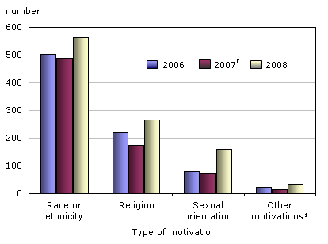
Chart of hate crimes around the world

Slide 4
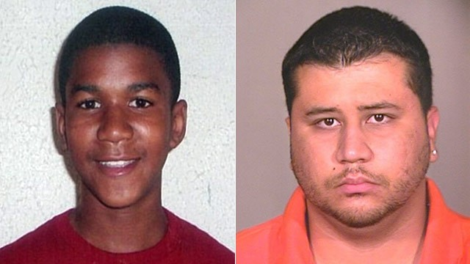
How to prevent hate crimes
First look at the news read the news paper to gather information on different hate crimes going on around the world
Second raise awareness in your neighbor hood
Third go to different schools and talk to them about the affect of hate crimes going on in the world
Last tell everybody what can happen if you hate on other people

Slide 5
Examples of hate crimes
People killing each other over their race, how they look, and etc
Calling people names about how the look
Last people talk about how the walk talk and where they from those are all examples of hate crimes

Slide 6
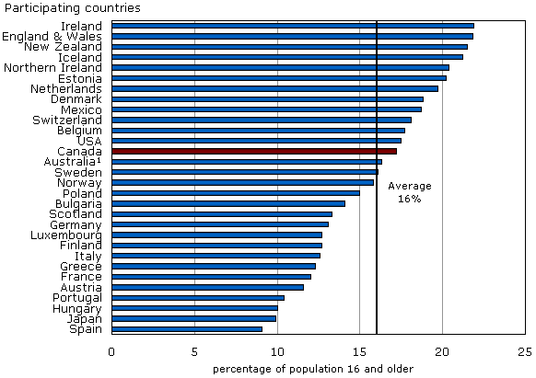
A chart of where most hate crimes happen at

Slide 7
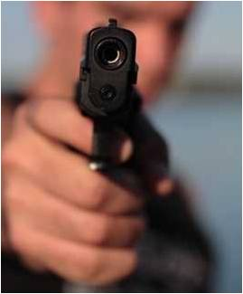
What is the affects of hate crimes
People kill them selfs
They murder people
They fight over words that was said .

Slide 8
HOW TO AVOID PEOPLE WHO ARE MESSING WITH YOU
FIRST WALK A WAY
SECOND TELL ADULT OR SOMEBODY WHO YOU CAN TRUST
IF IT KEEPS ON HAPPENING CALL THE POLICE AD TELL THEM WHAT HAS BEEN HAPPENING THOSE ARE ALL STEPS TO PREVENT PEOPLE WHO ARE MESSING WITH YOU

Slide 9
Summery of what I learned from this
I learned that hate crimes are bad no matter what anybody says. I also learned that hate can lead to violence .if I had a choice I would talk to children about about the affects hate crimes can have on people families.

Slide 10
Informational sites
http://www.beyondhomophobia.com/blog/category/hate-crimes/
http://en.wikipedia.org/wiki/Hate_crime
http://www.civilrights.org/about/
http://www.fbi.gov/about-us/investigate/civilrights/hate_crimes
http://www.adl.org/combating_hate/

